Slide 1
REINFORCEMENT SQL
R.PAVITHRA
03/03/2025

Slide 2
INTRODUCTION
Overview of the IMDb dataset
Objective: To extract insights using SQL queries
Key focus areas:
Data distribution
Data quality
Trends and patterns

Slide 3
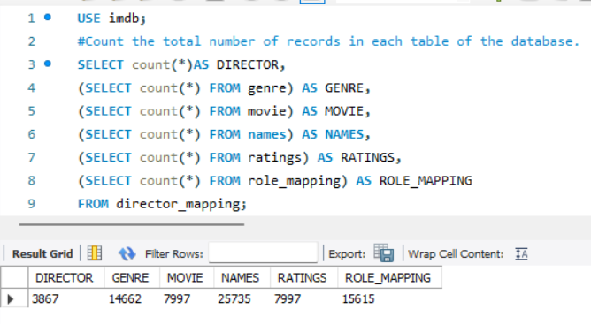
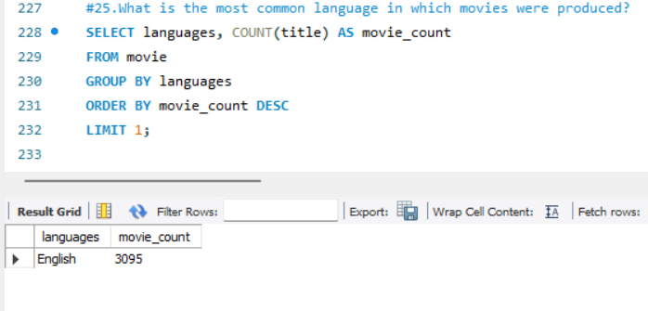
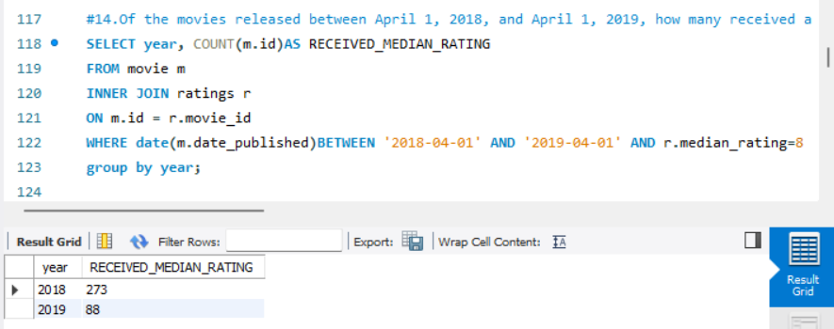
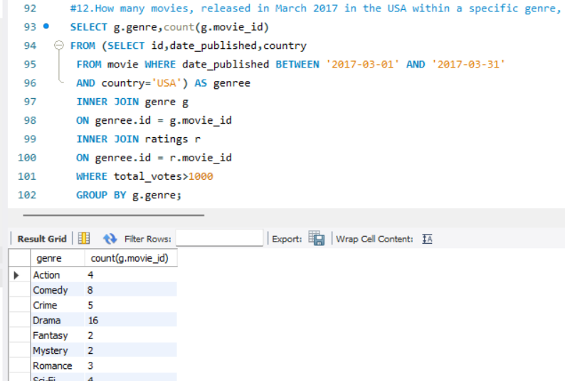
COUNT RECORDS
Counting total records
in each table
Helps understand the
dataset size and distribution.

Slide 4
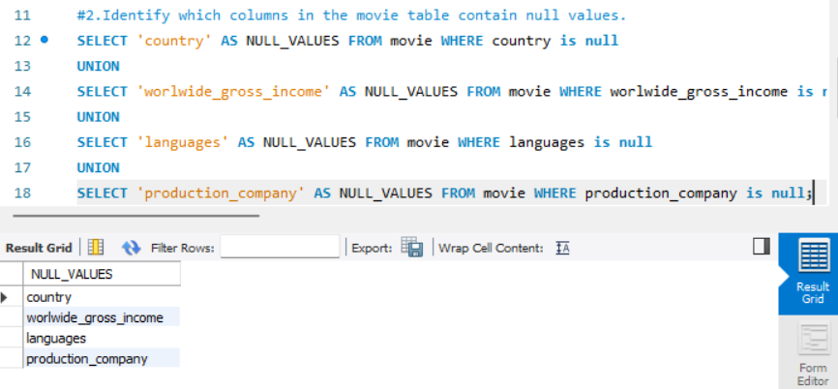
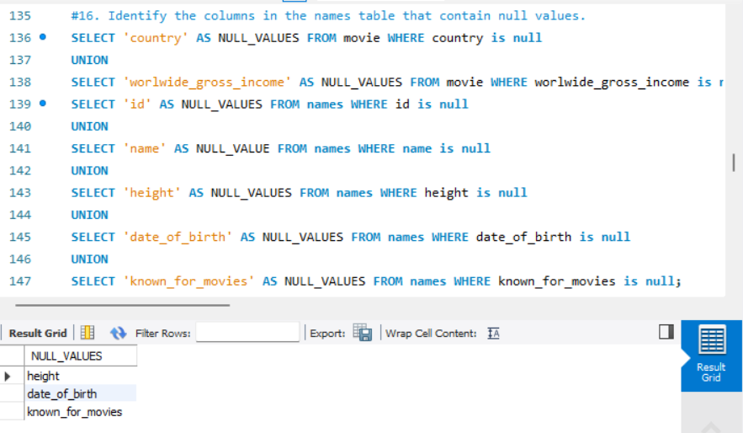
Data Quality Analysis
Identifying NULL values in important columns of the movie and names table

Slide 5
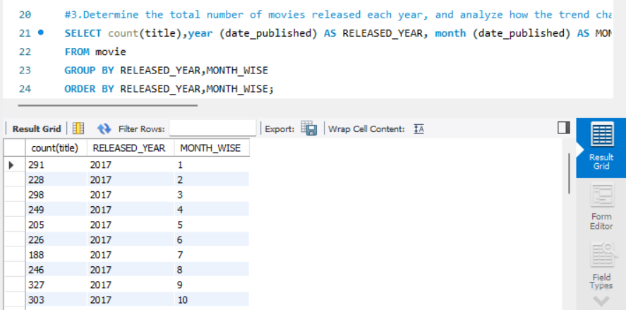
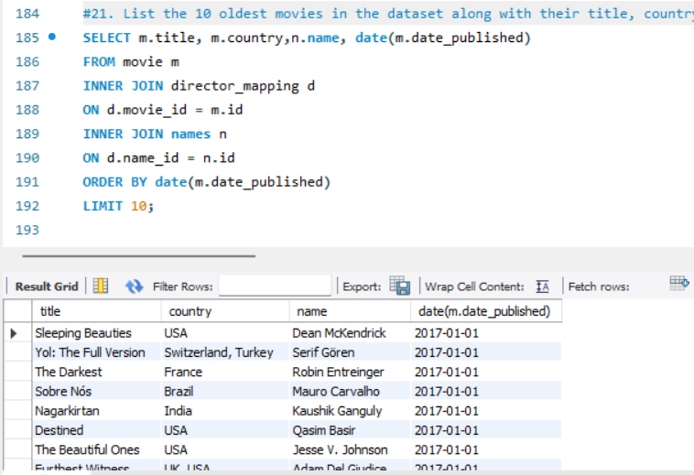
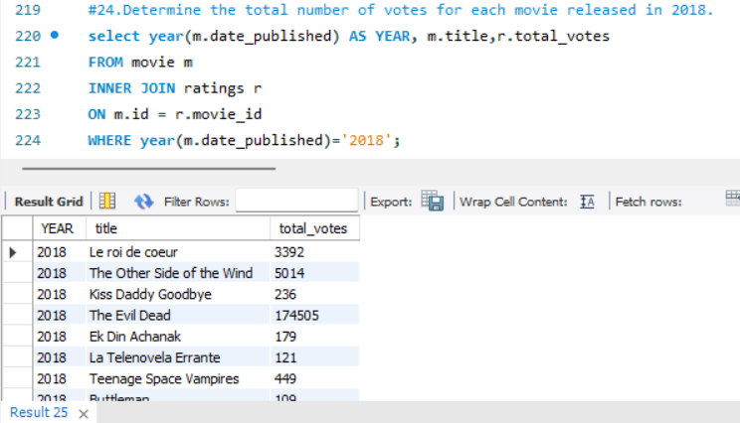
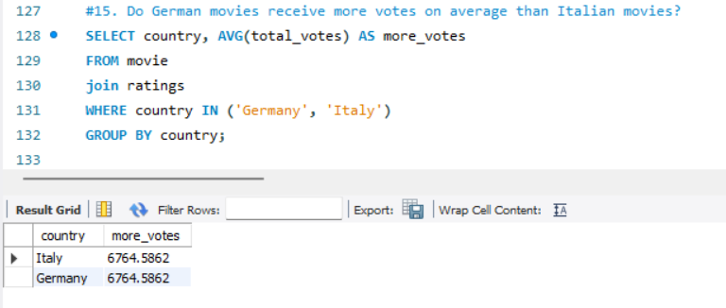
Movie BASED
Analyzing the total number
of movies released each
year and month
Oldest movie
Produced
Votes

Slide 6
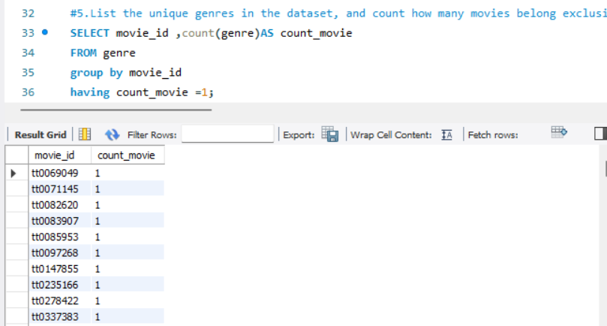
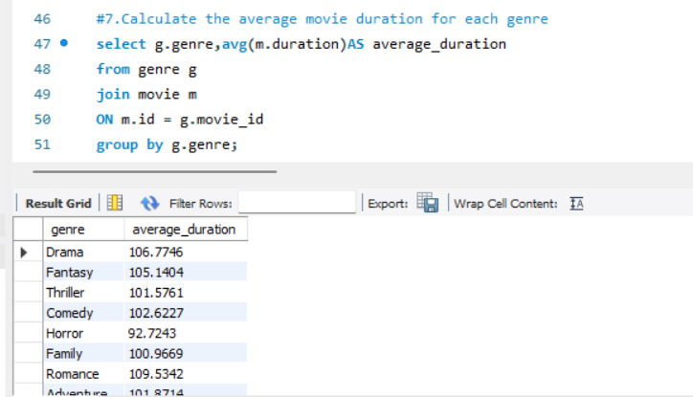
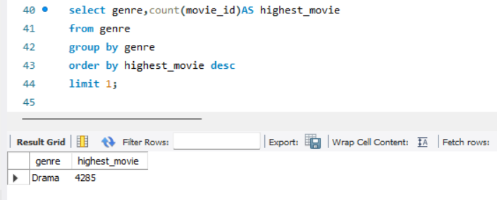
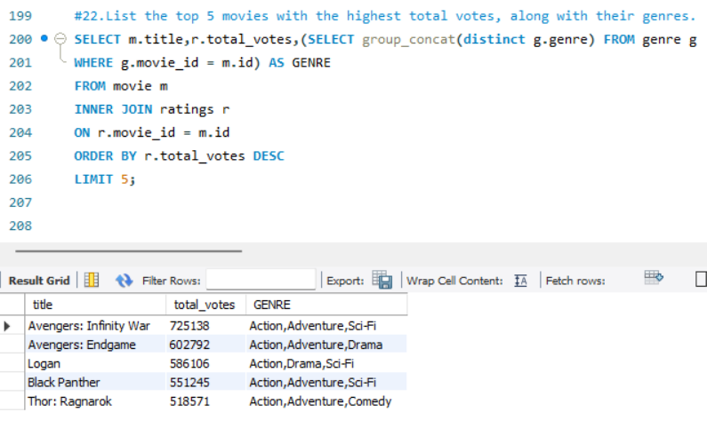
Genre-Based
Unique genres
Exploring popular genres
Duration for each genre

Slide 7
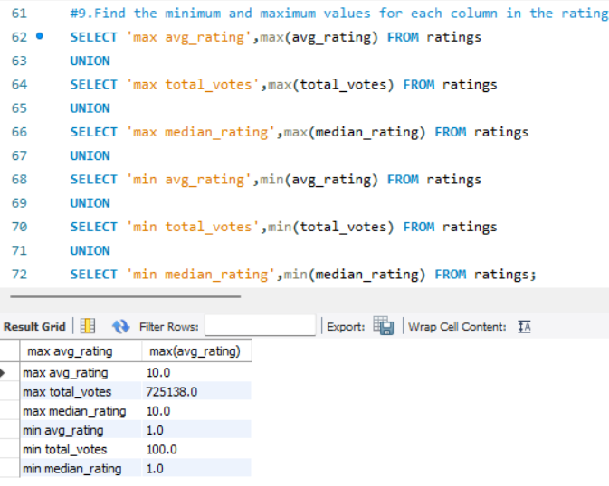
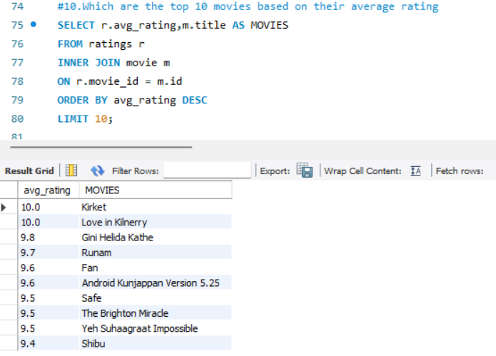
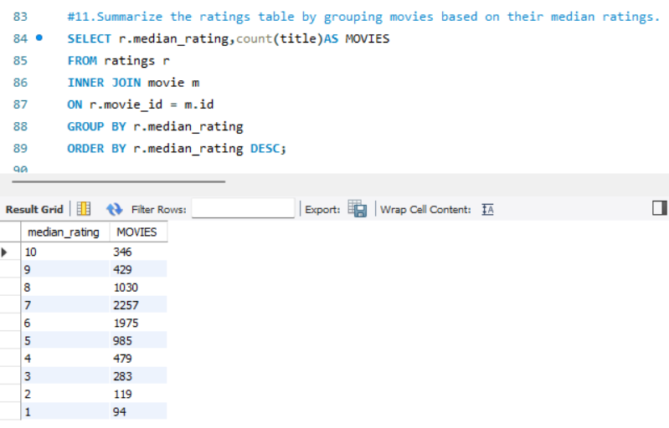
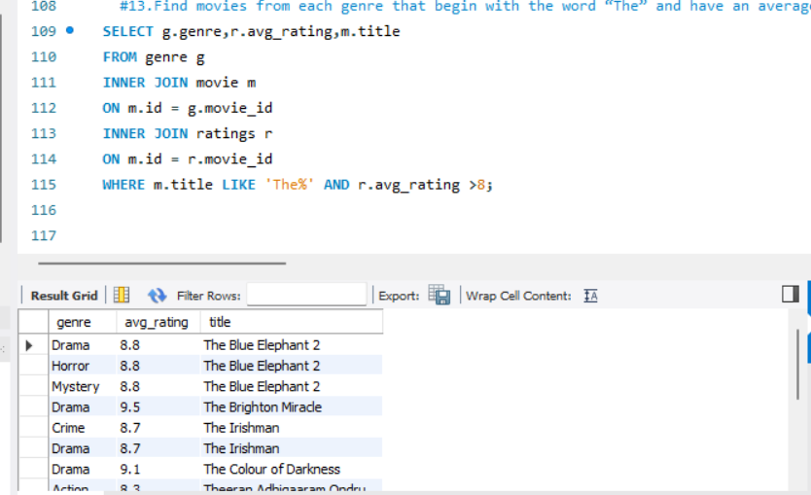
Ratings Analysis
Understanding ratings
distribution
Median Rating
Average Rating
Max-Min Rating

Slide 8
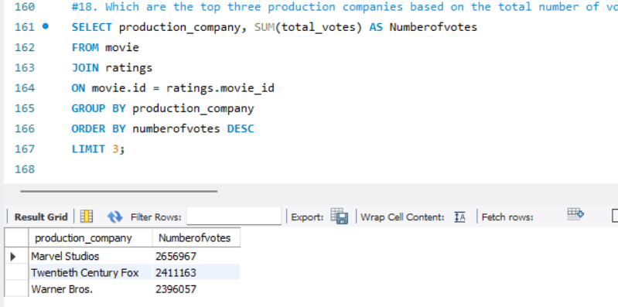
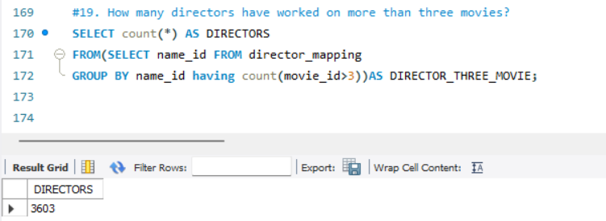
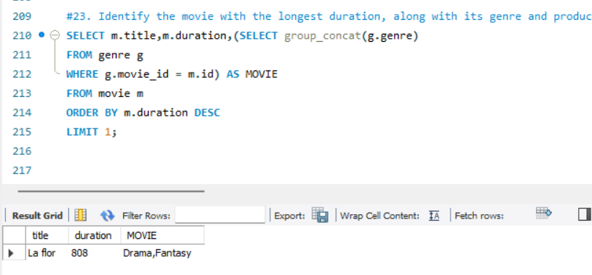
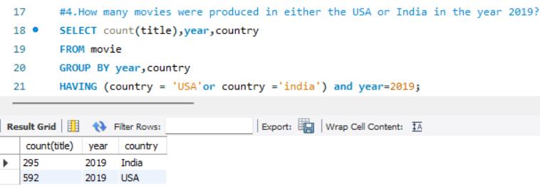
Role MAPPING AND Director
Analyzing relationships
Director works Three movie
Produced movie

Slide 9
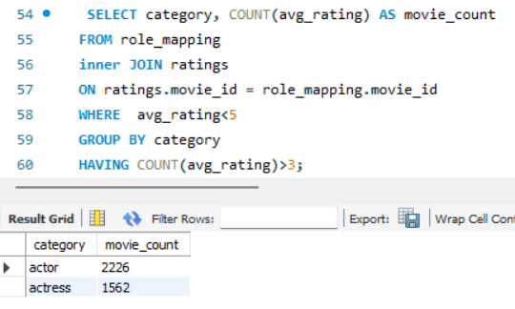
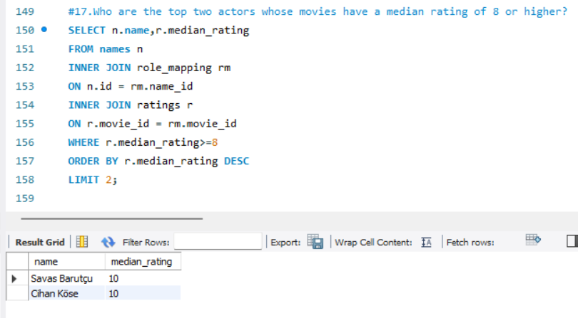
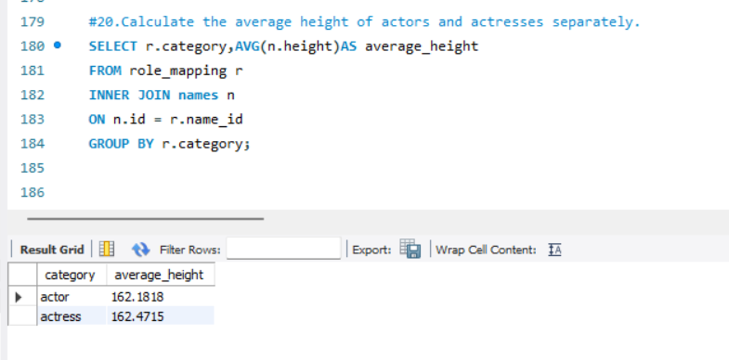
ACTORS BASED
Identify actors or actresses
Average height
Top Actor

Slide 10
CONCLUSION
Trends related to -movie genres, ratings, and director contributions.
Genres
Assessed movie performance through average ratings.
Identified prolific directors.
Analysis of actor performance.
Genre-director.

